Slide 1
1 2 3 4 5 6 7 8 9 10 11 12
The numbers 1-12
naturally form four groups
First Principles: 1, 2
Numbers of Structure: 3, 4, 6, 8, 12
Numbers of Life: 5, 10
Numbers of Mystery: 7, 9, 11
Michael S. Schneider
www.constructingtheuniverse.com

Slide 2
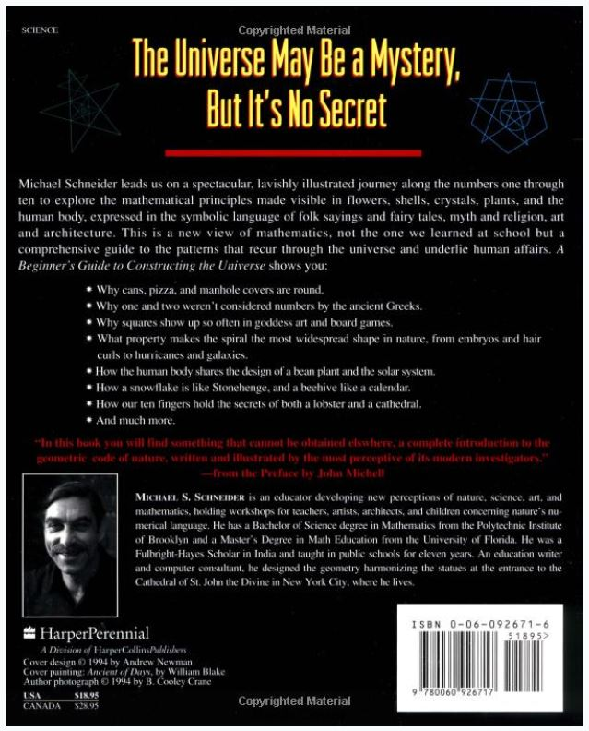
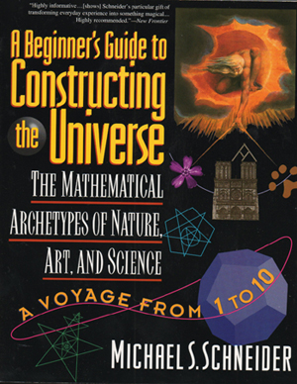

Slide 3

1 2 3 4 5 6 7 8 9 10 11 12
Page 65
The Heptad
Number of Sacredness and Mystery

Slide 4
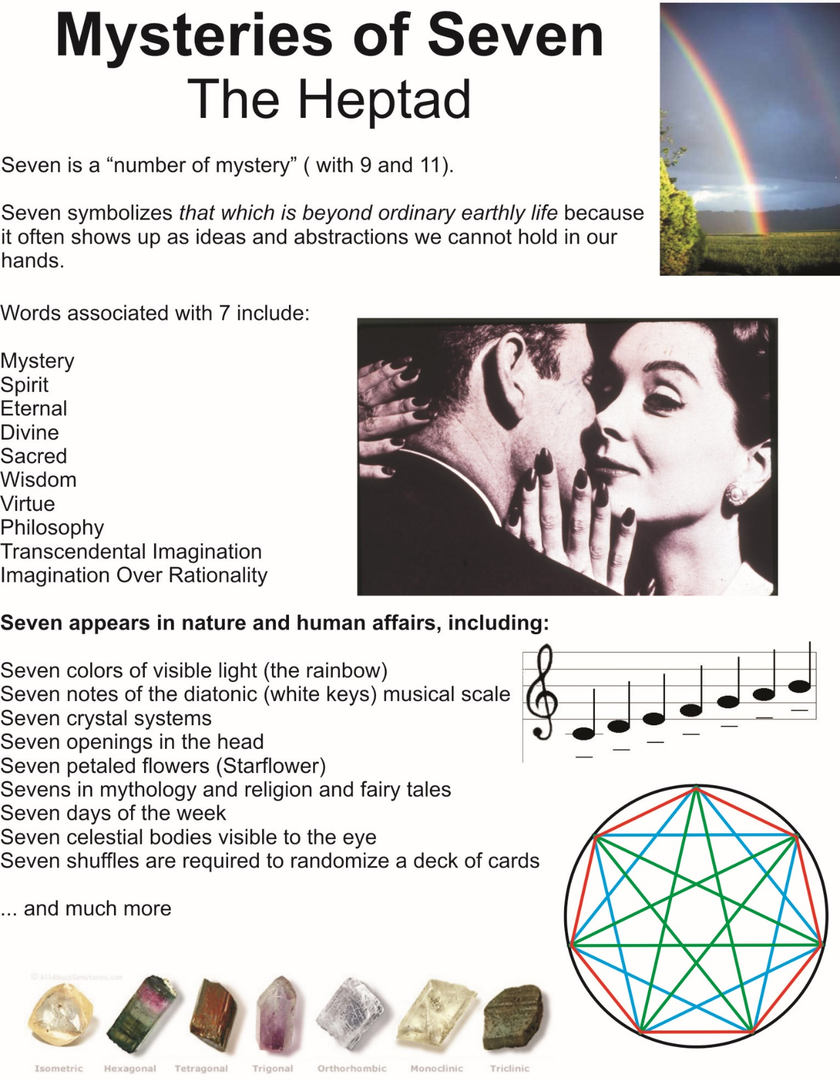

Slide 5
Seven symbolizes
that which is beyond ordinary earthly life
Words associated with 7 include:
Spirit
Eternal
Divine
Sacred
Wisdom
Virtue
Philosophy
Transcendental Imagination
Imagination Over Rationality

Slide 6
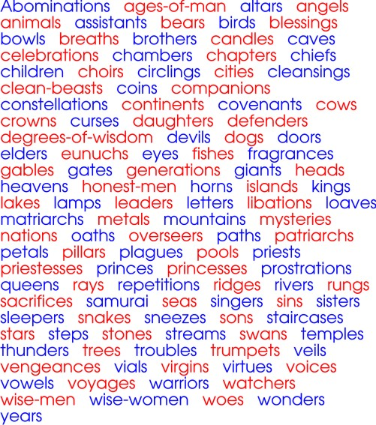
7
In mythologies, fairy tales, folk tales, religions, fables, proverbs & legends…

Slide 7
7 is a Point of Balance in the Decad (1-10)
as Chasm: 1 x 2 x 3 x 4 x 5 x 6 = 8 x 9 x 10 = 720
as Bridge: 1 x 2 x 3 x 4 x 5 x 6 x 7 = 7 x 8 x 9 x 10 = 5040
Balance occurs whether 7 is there or not!

Slide 8
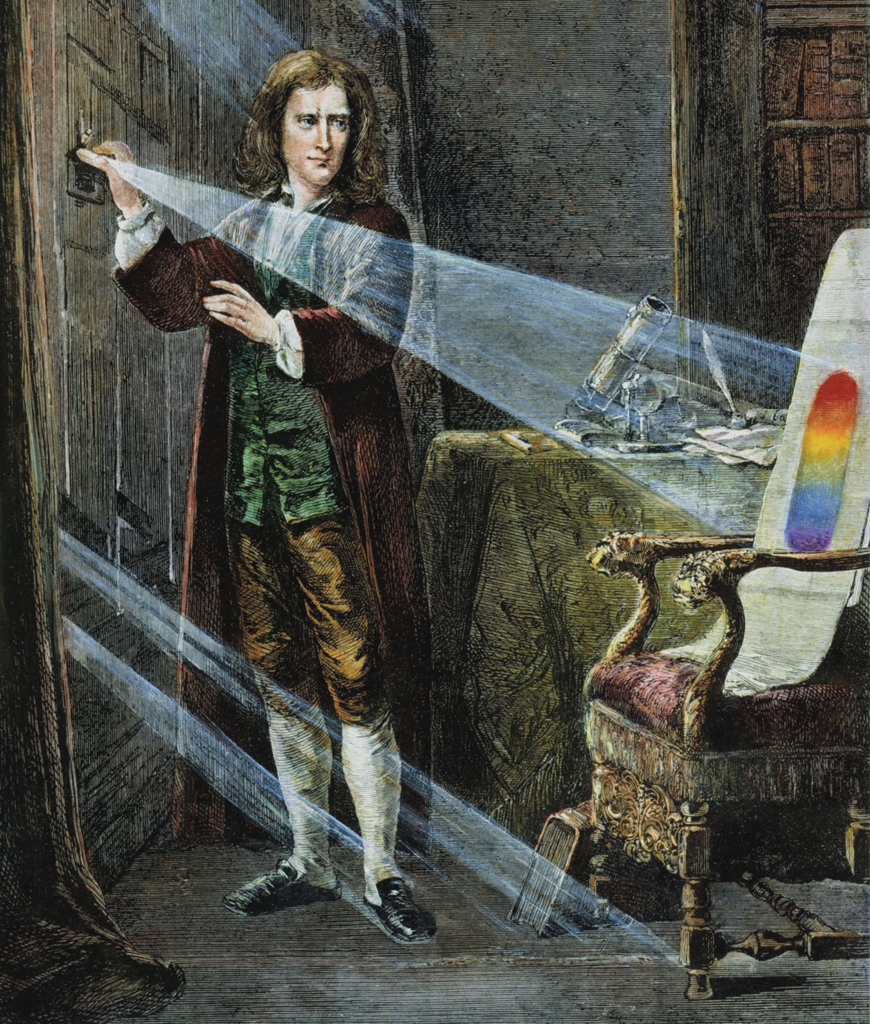
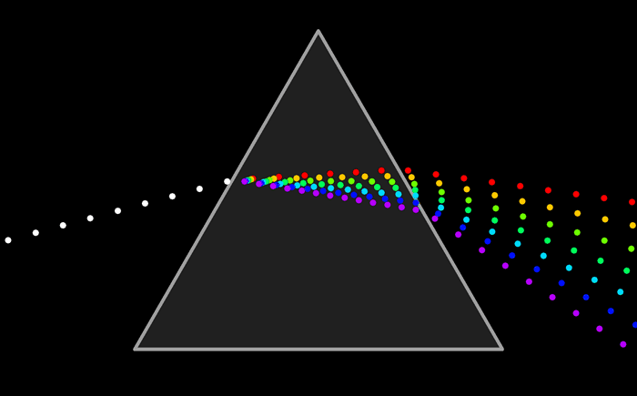
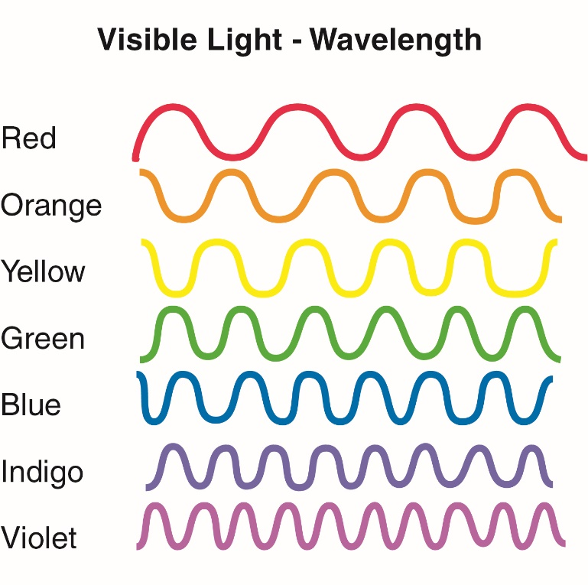
White light refracts into 7 colors
Sir Isaac Newton

Slide 9
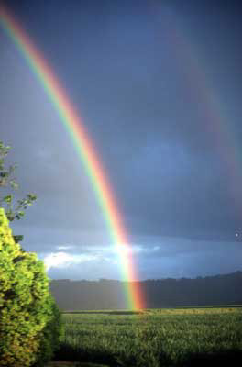
You can only see a rainbow if the sun is behind you.
Notice the “double rainbow” (with its colors in reverse order!

Slide 10
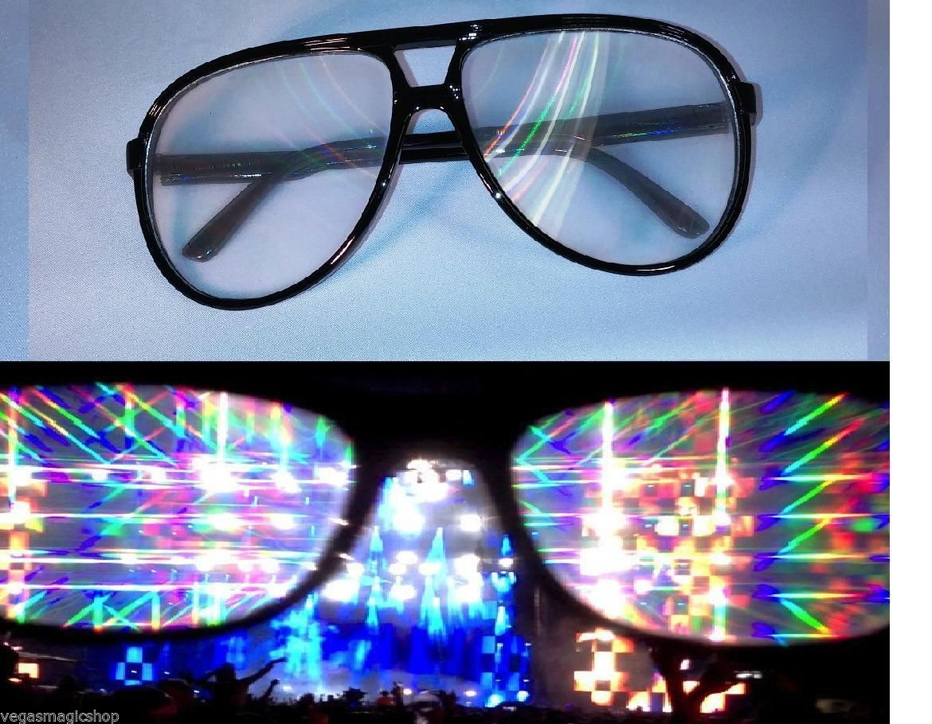
Prismatic Glasses

Slide 11
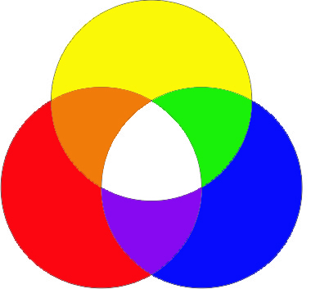
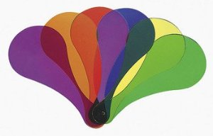
Mixing colors (wavelengths or frequencies) of light

Slide 12
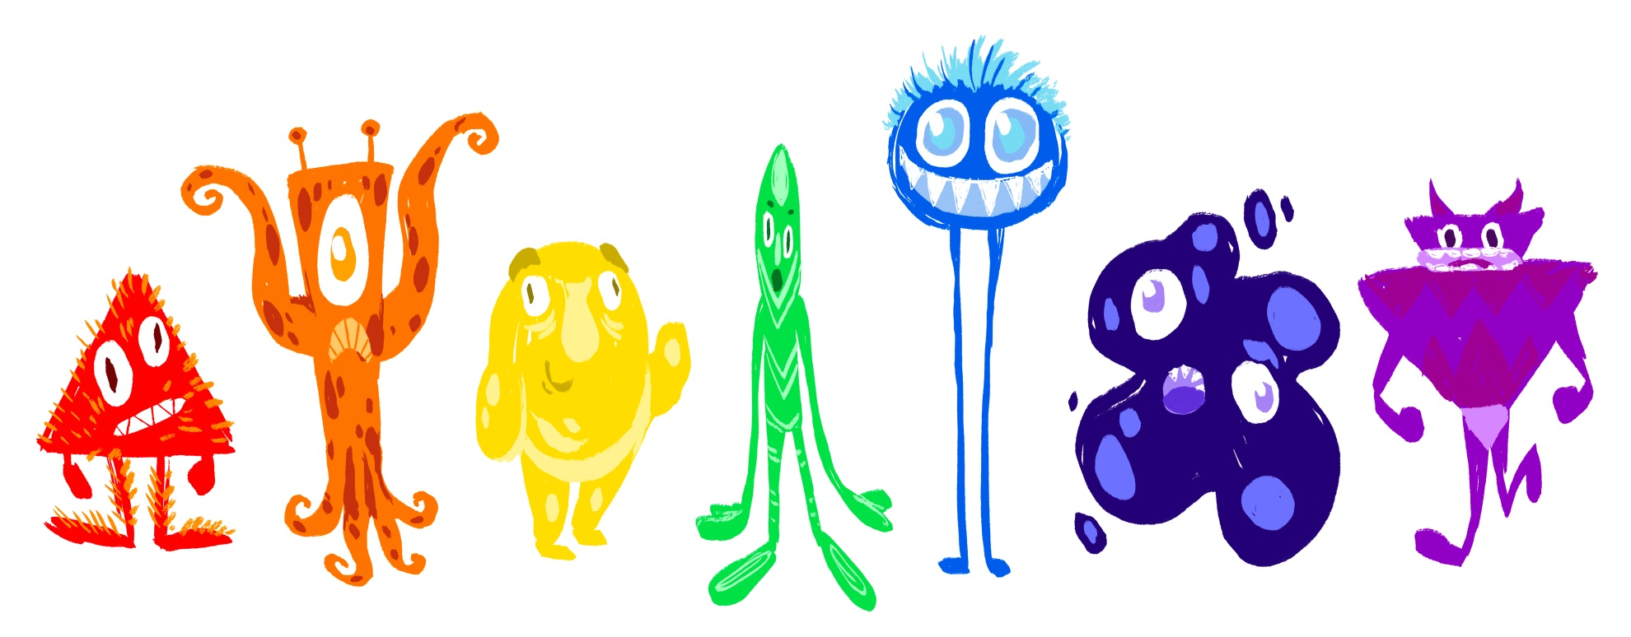

Slide 13
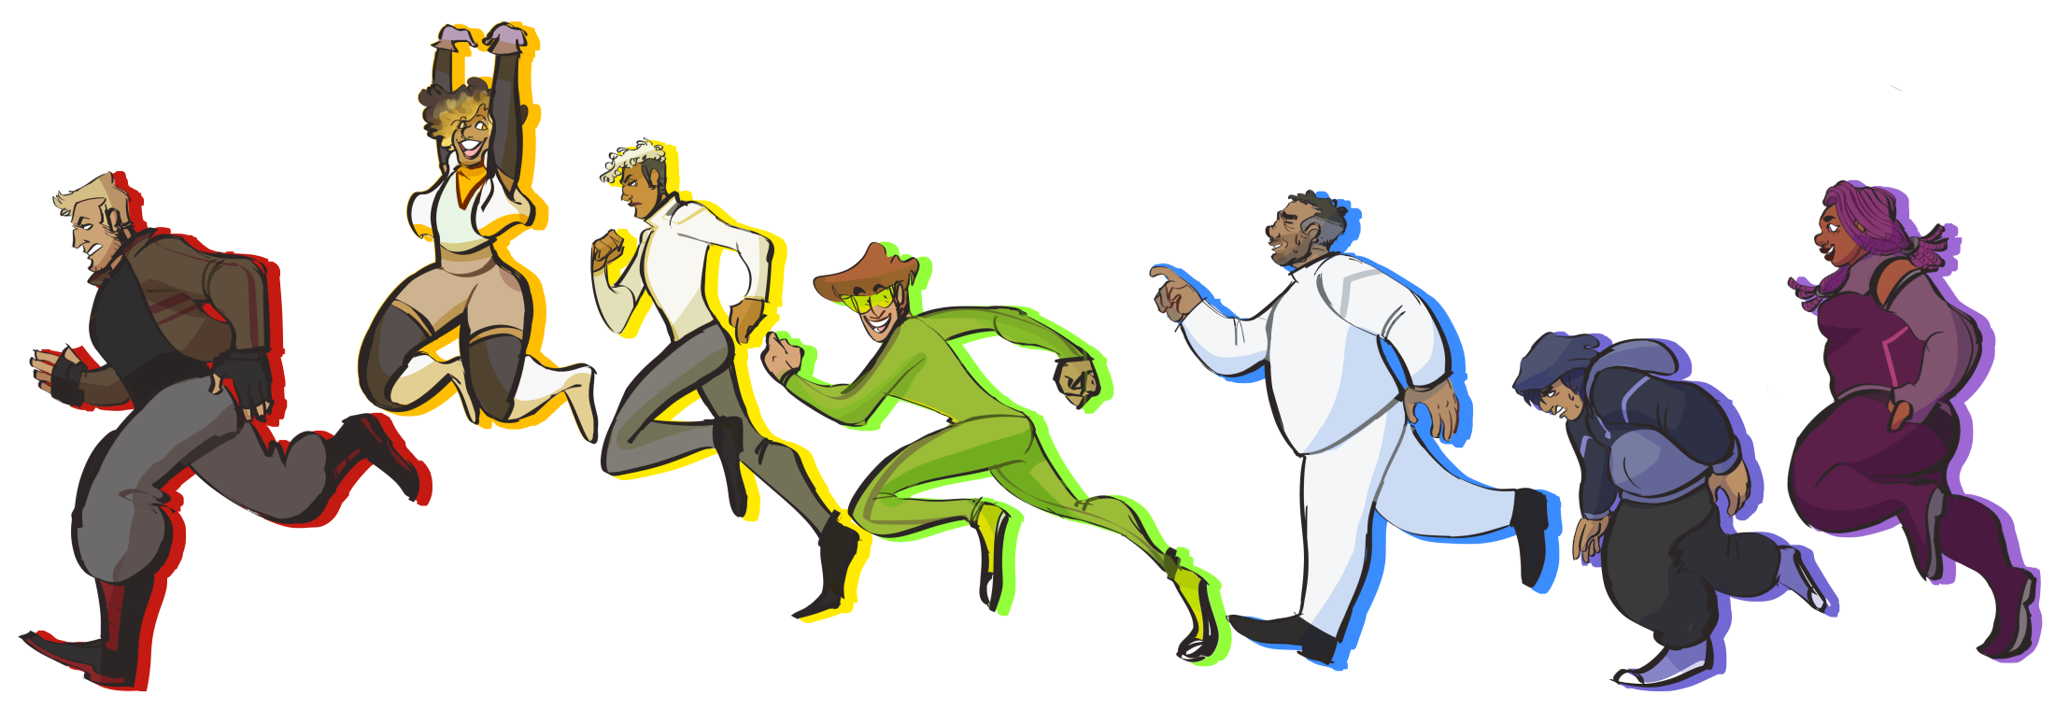

Slide 14

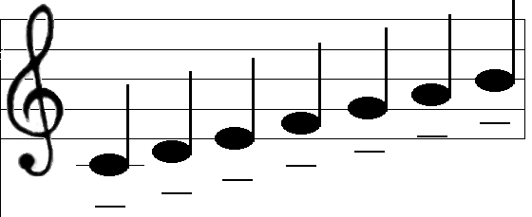
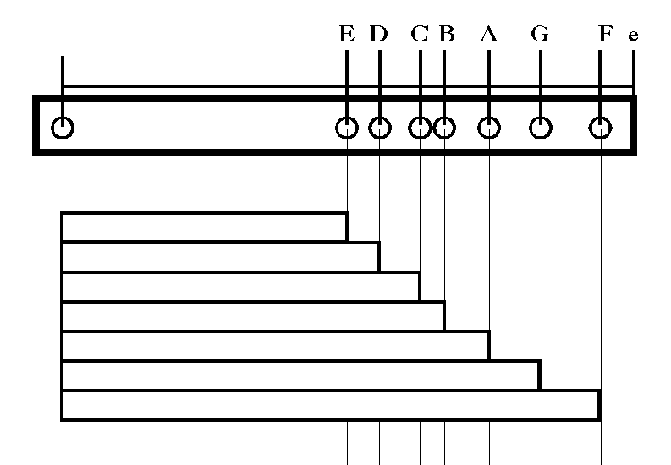
The seven note “diatonic” musical scale of flutes and pan-pipes was characteristic of tribal, wandering, nomadic societies before settled civilizations
A discovery, not an invention.

Slide 15
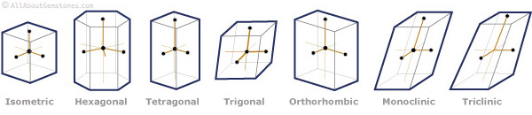
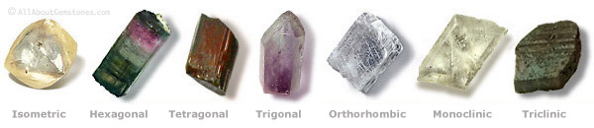
There are no 7-sided crystals, but there are
Seven Crystal Systems

Slide 16
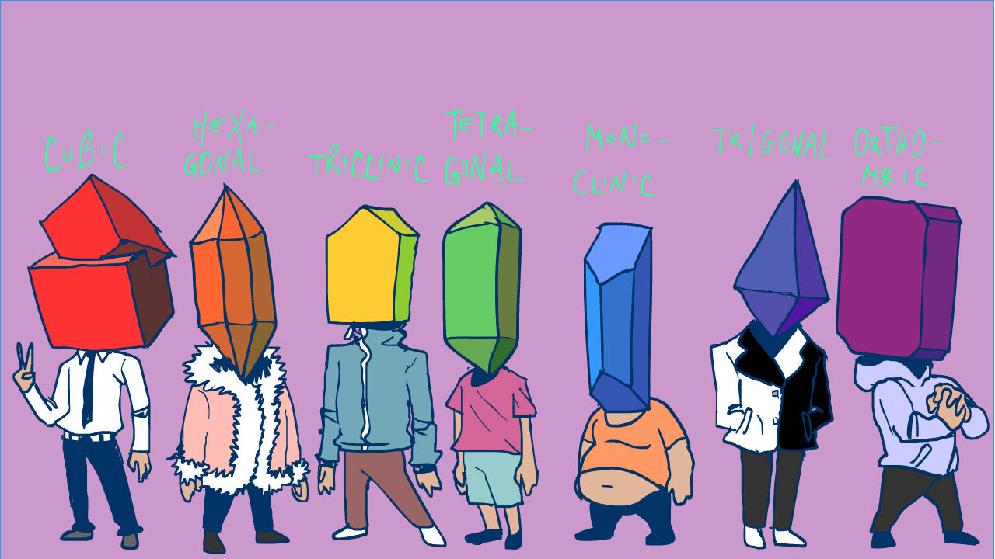

Slide 17
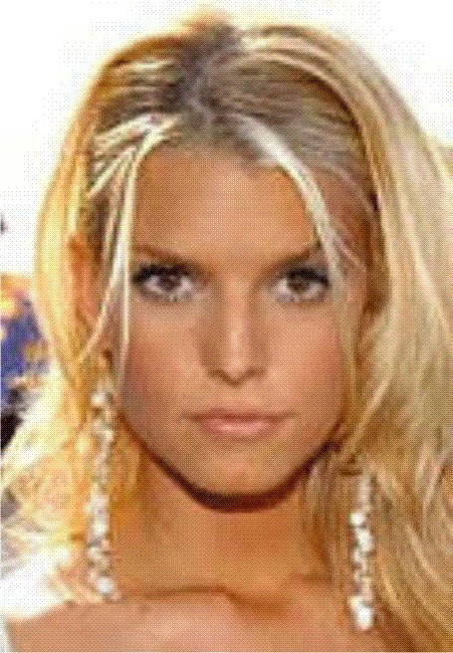
2 Eyes
2 Ears
2 Nostrils
+ 1 Mouth
7 Openings

Slide 18
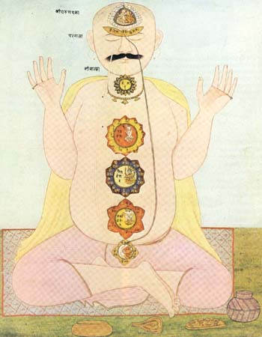
7 Chakras
Centers of motivation

Slide 19
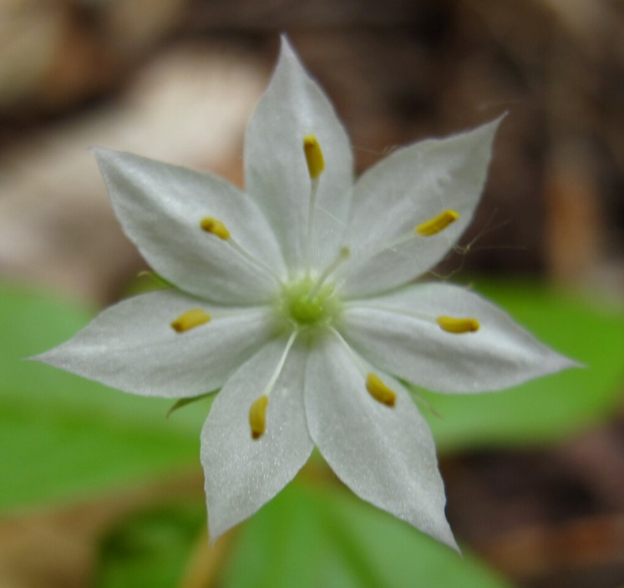
Poppy
Starflower

Slide 20
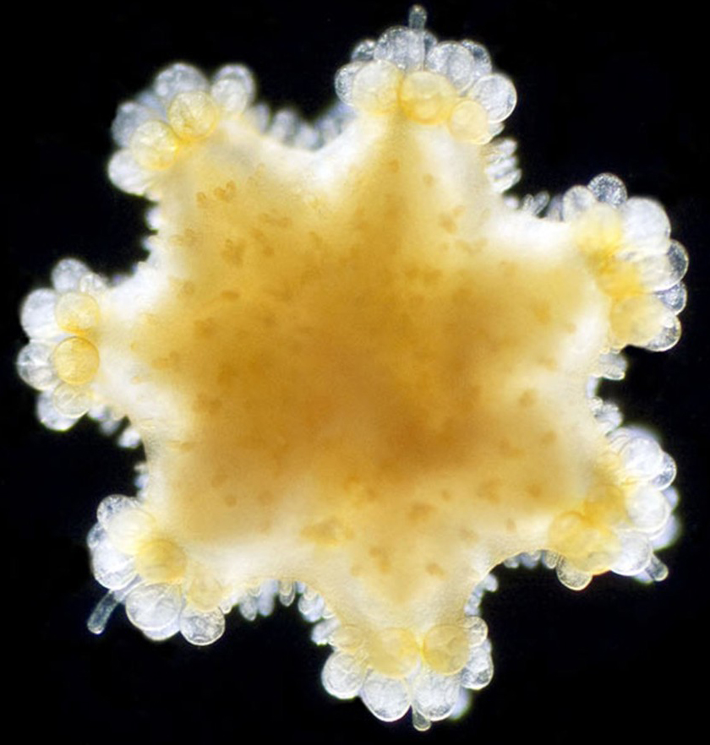
Microscopic Plankton
(a plant)
Planktos: Greek word for
“Drifter”

Slide 21
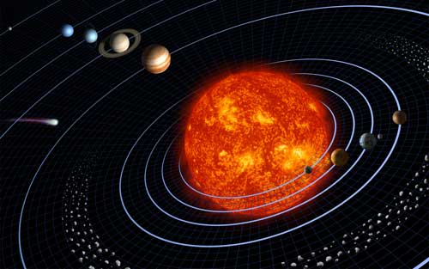
7 Celestial Bodies can be seen from Earth with our eyes only
(no telescope needed!)
Sun
Moon
Mercury
Venus
Mars
Jupiter
Saturn

Slide 22
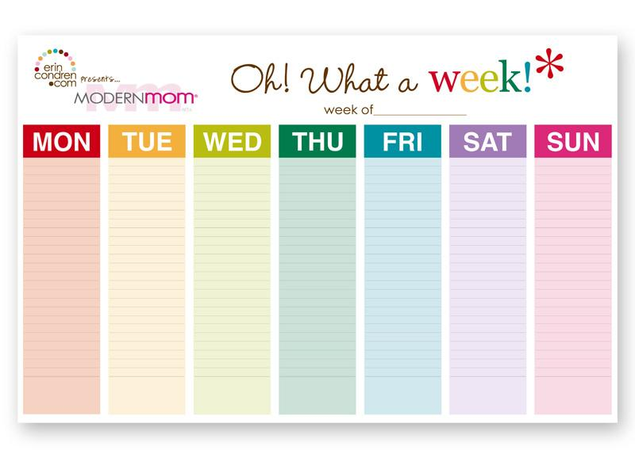
The 7 days of the week are named after the 7 visible celestial bodies
(If it’s not obvious in English, say it in Spanish.)
Norse god
Tiw
Woden
Thor
Frige
Celestial
body
Moon
Mars
Venus
Saturn
Sun
Mercury
Jupiter
Spanish
lunes
martes
miércoles
jueves
viernes
sábado
domingo

Slide 23
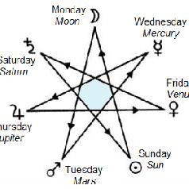
Table of 7-fold Correspondences
Heavenly Day Musical Color Metal Jewel Greek Sound
Body Note Vowel
Moon Monday A white silver pearl alpha short a
Mercury Wednesday G indigo quicksilver amethyst eta long E
Venus Friday F green copper emerald epsilon short e
Sun Sunday E yellow gold topaz iota short i
Mars Tuesday D red iron ruby omicron o
Jupiter Thursday C blue tin sapphire upsilon y
Saturn Saturday B black lead diamond omega long O
from How The World Is Made by John Michell and Allan Brown

Slide 24
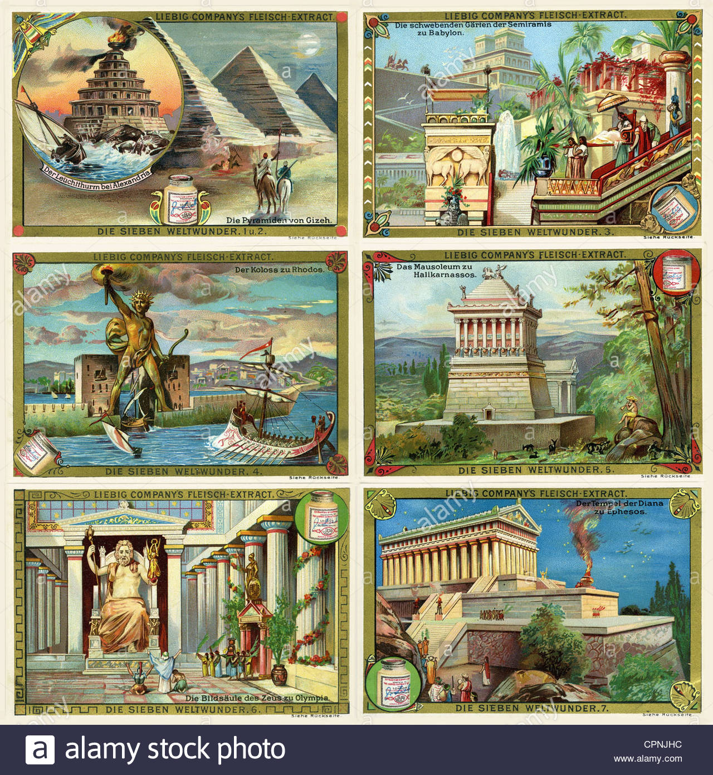
7 Wonders of the Ancient World
THE LIGHTHOUSE OF ALEXANDRIA
THE GREAT PYRAMID OF GIZA
THE HANGING GARDENS OF BABYLON
THE COLOSSUS OF RHODES
THE MAUSOLEUM AT HALICARNASSUS
THE STATUE OF ZEUS AT OLYMPIA
THE TEMPLE OF ARTEMIS AT EPHESUS

Slide 25
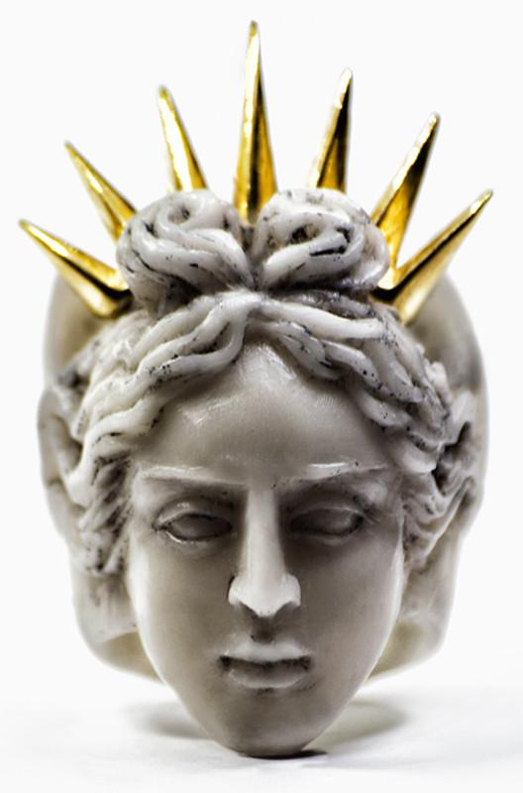
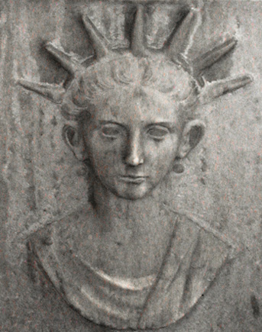

Slide 26
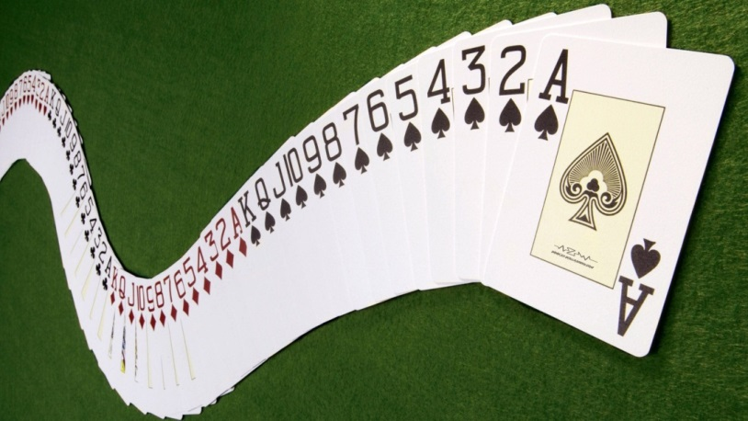
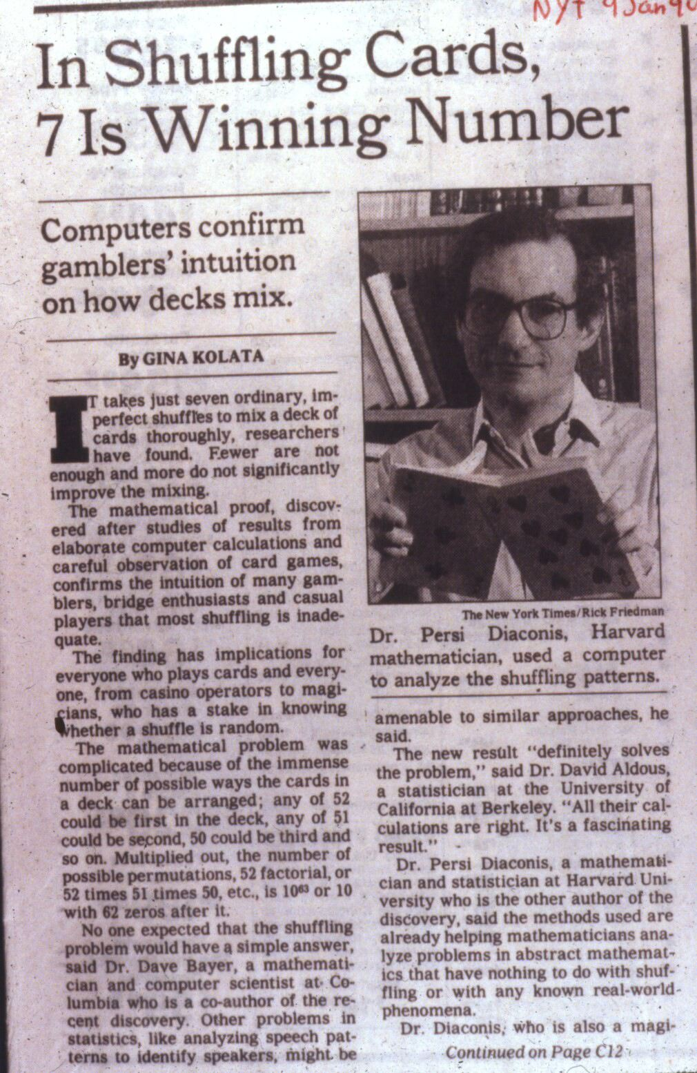
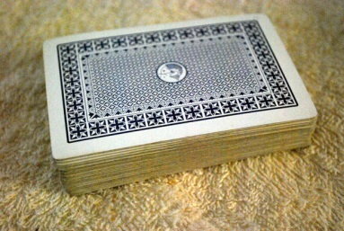
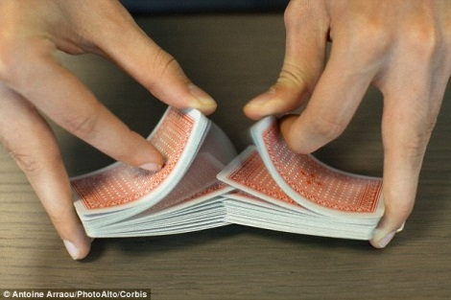
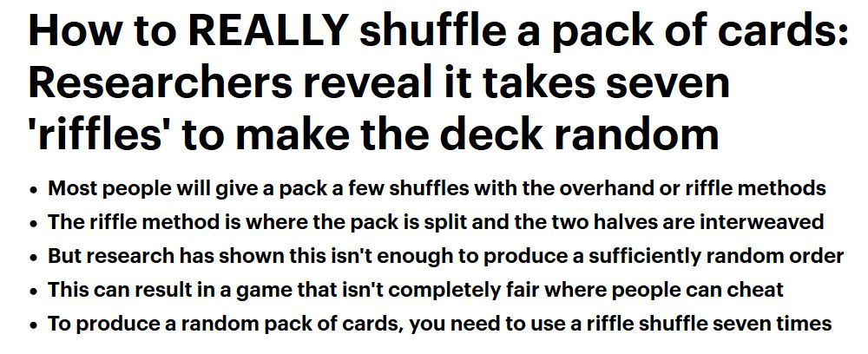
A deck of cards
must be shuffled
at least 7 times
to become truly randomized

Slide 27
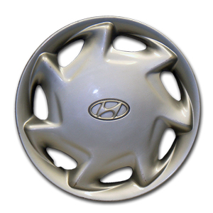

Slide 28
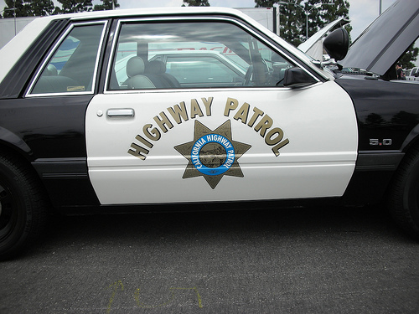


Slide 29
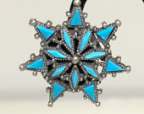
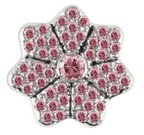
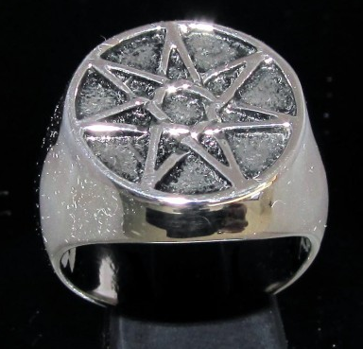
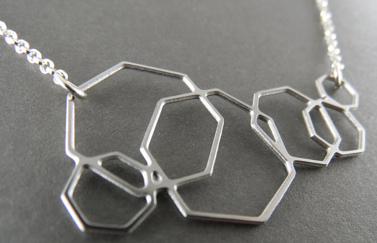

Slide 30
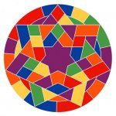
Sol Lewitt

Slide 31
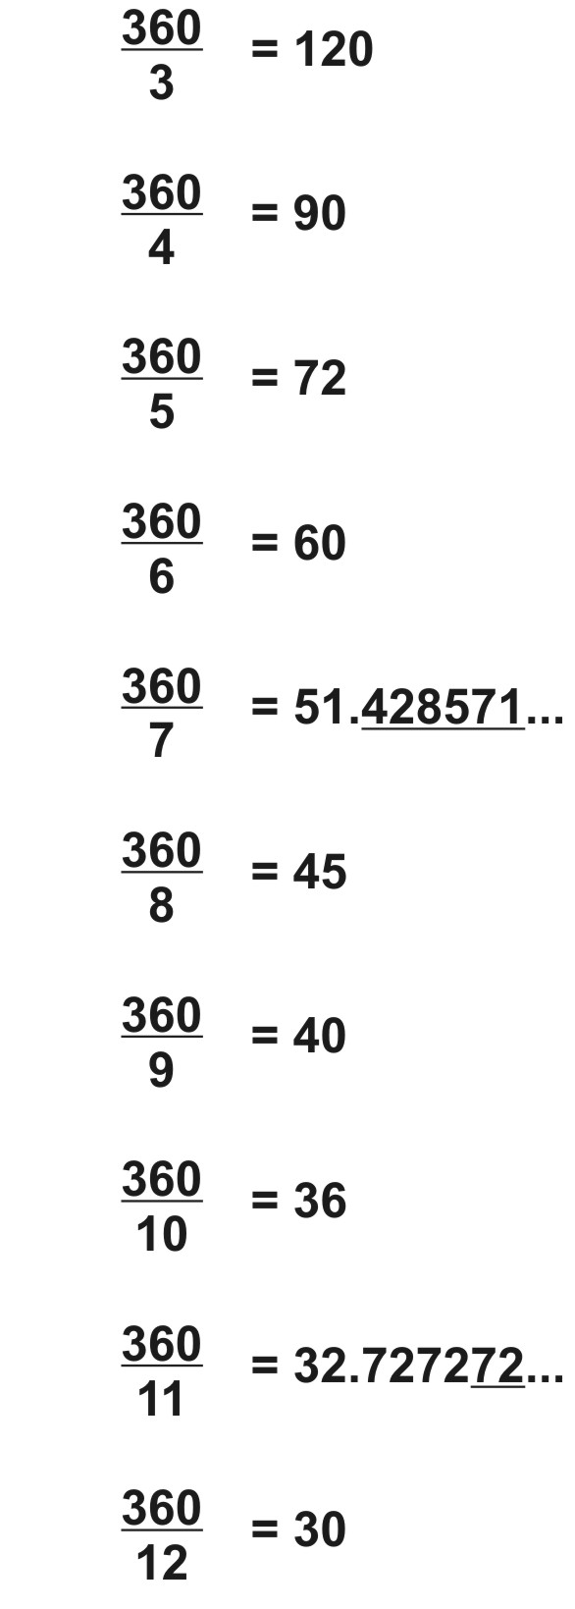
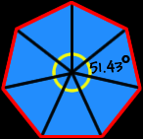
An exact heptagon cannot be constructed with compass & straightedge because it’s not possible for them to make this endless-decimal angle.

Slide 32
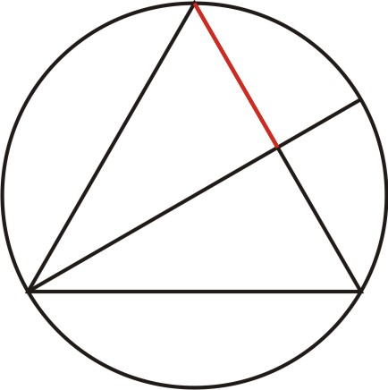
This is where (approximately) one side of a Heptagon is found.

Slide 33
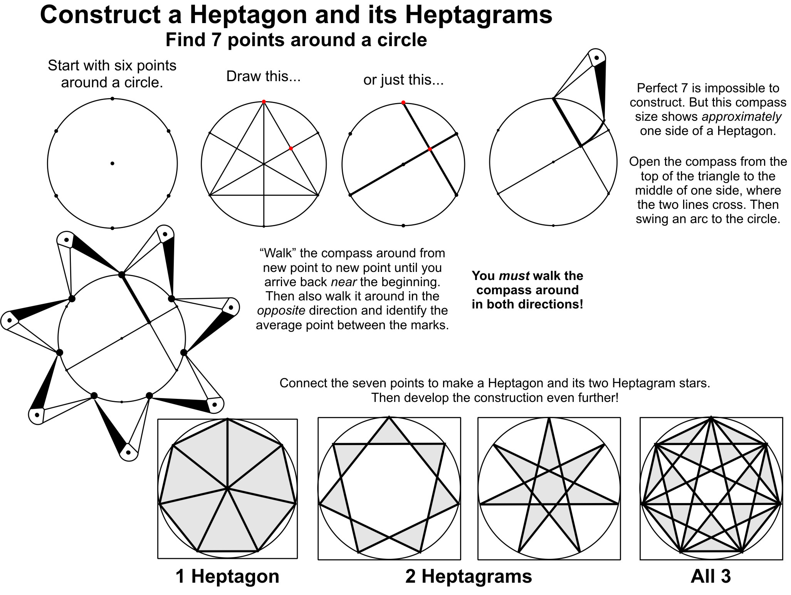
Page 66

Slide 34


Slide 35
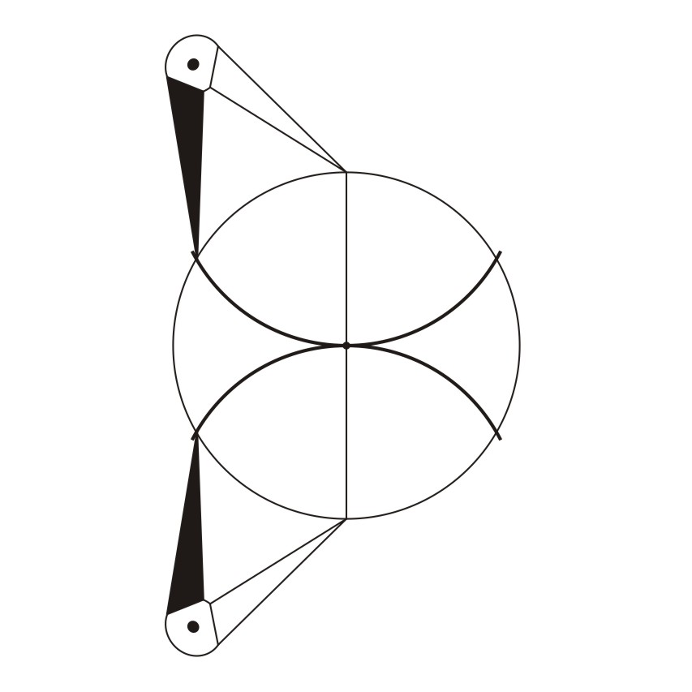
Find 6 equally-spaced points around the circle.

Slide 36
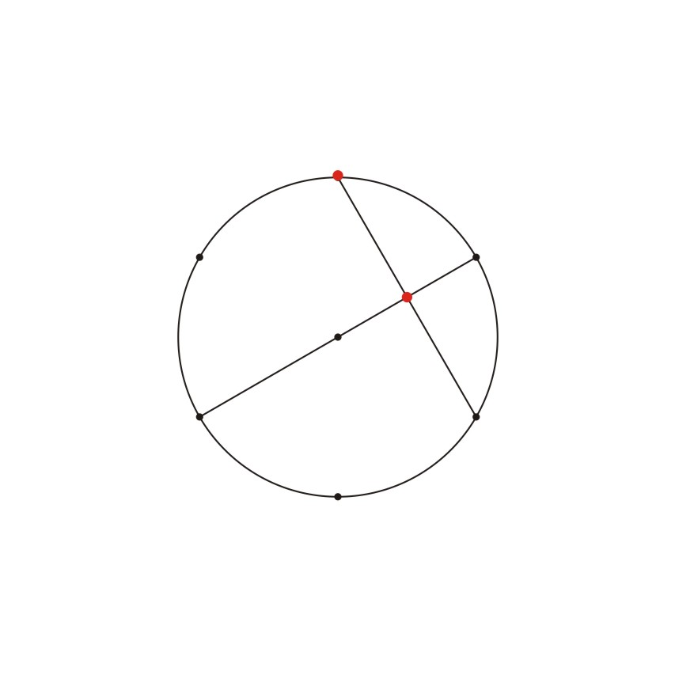
The minimum number of lines to be drawn.

Slide 37
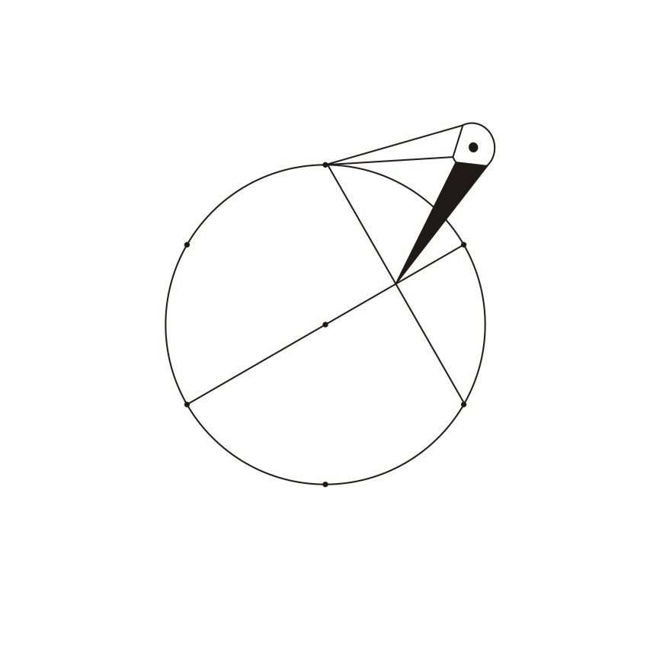

Slide 38
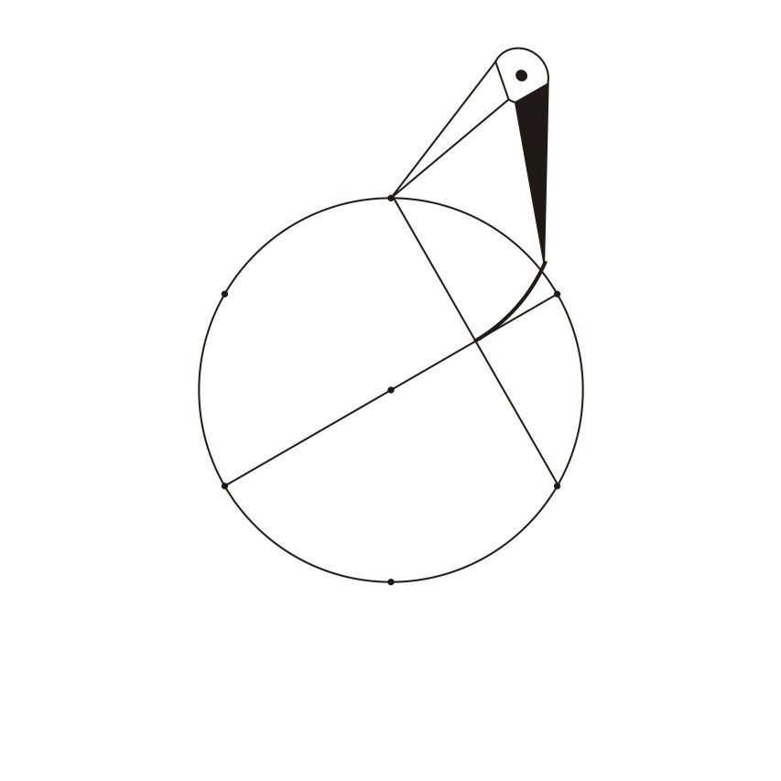

Slide 39
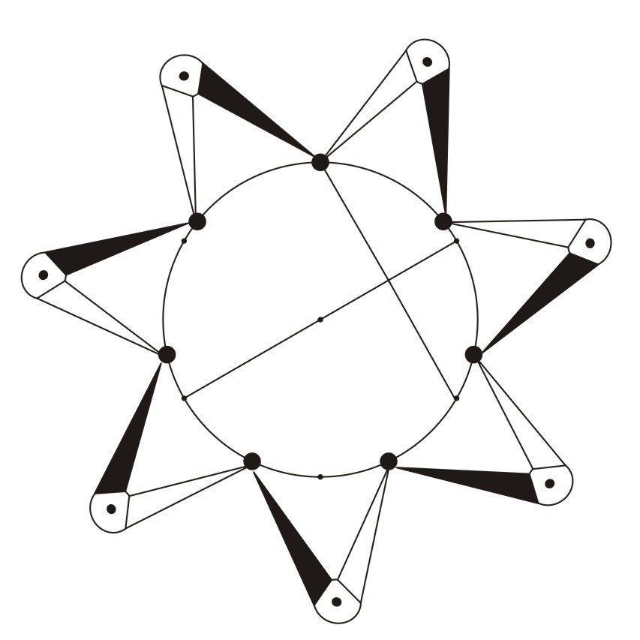
For greatest accuracy, “walk” the compass around in both directions.

Slide 40
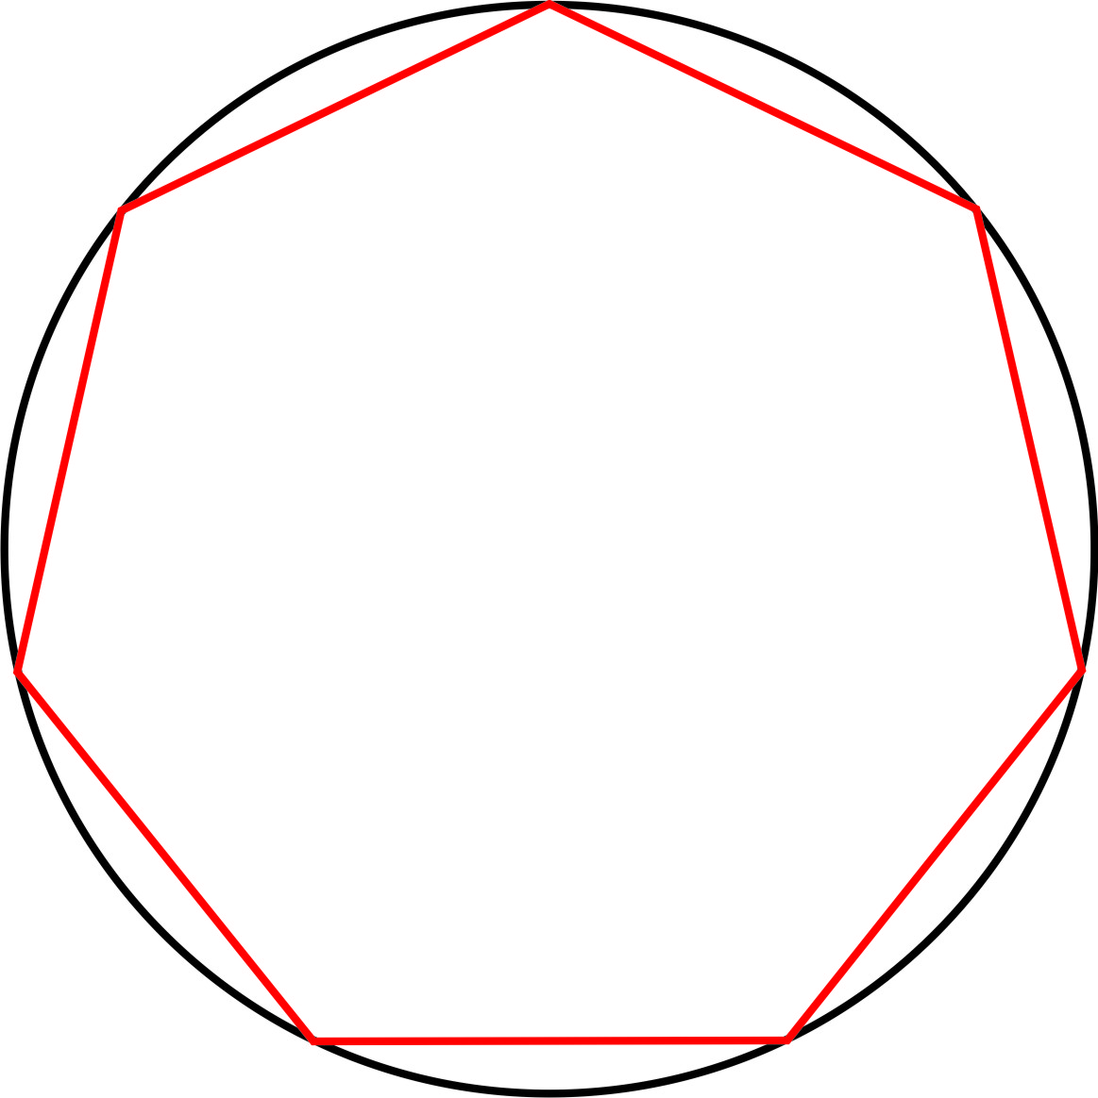
Heptagon

Slide 41

Heptagram
1

Slide 42


Slide 43

Heptagram
2

Slide 44


Slide 45

Heptagon with both its Heptagrams

Slide 46


Slide 47



Slide 48

Page 67

Slide 49


Page 67

Slide 50


Page 67

Slide 51


Page 67

Slide 52






What homework will I create to give to her as a gift?

Slide 54



Page 68

Slide 55

“A 7-sided figure is impossible to draw
With perfect mathematical precision;
And if you try to do it you are absolutely sure
To find your efforts treated with derision.
And yet there are philosophers who readily declare
That nothing in this world is really true.
And so I’ve drawn a heptagon by triangle and square,
For any human purpose it will do.”
-- John Michell

Slide 56




The opposite sides of each “die” add to 7.
Dice can be left-handed or right-handed
Roll 2 dice: 7 will come up more often than any other number
(6 ways it can happen).

Slide 57


Slide 58


Slide 59



Slide 60

The 7 colors we see are only a very small part of all possible
wavelength-colors.

Slide 61


